Slide 1
Detectron2
Facebook AI Research’s (FAIR) next-generation platform for object detection and segmentation.

Slide 2
Overview
Part 1 (today)
What is Detectron2?
What are object detection and segmentation?
Quick Demo
Part 2
Models for object detection and segmentation
Faster-RCNN
Mask-RCNN
Part 3
Using the API
Creating custom datasets

Slide 3
Detectron2
Detectron2 was built by Facebook AI Research (FAIR) to support rapid implementation and evaluation of novel computer vision research.
Image Detection and segmentations are different from classification, but related.
Uses PyTorch
It includes implementations for the following object detection algorithms:
Mask R-CNN
RetinaNet
Faster R-CNN
More
Includes trained parameters (checkpoints) for large detection databases used in research competitions
COCO – Common Objects in Context
LVIS – Large Vocabulary Image Segmentation

Slide 4
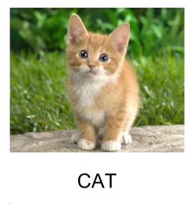
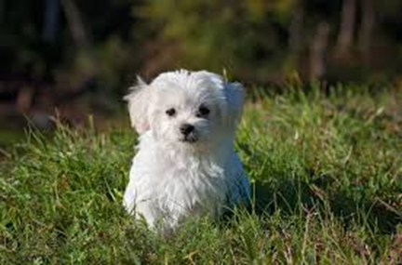
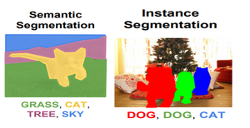
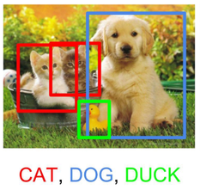
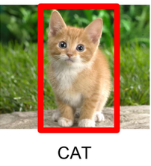
Image Detection Tasks
Method | Description | Example
Image Classification | Classify what is contained in an image.
Image Localization | Specify the location of single object in an image
Object Detection | Specifies the location of multiple objects in the image.
Image Segmentation | Create a pixel wise mask of each object in the images

Slide 5
Quick Demo
https://colab.research.google.com/

Slide 6
Detectron2 | https://github.com/facebookresearch/detectron2 https://detectron2.readthedocs.io/en/latest/index.html
COCO | https://cocodataset.org/#home
LVIS | https://www.lvisdataset.org/
CS 231 Lecture 11 | http://cs231n.stanford.edu/slides/2018/cs231n_2018_lecture11.pdf
Detectron2 Colab Tutorial | https://colab.research.google.com/drive/16jcaJoc6bCFAQ96jDe2HwtXj7BMD_-m5

